Slide 1


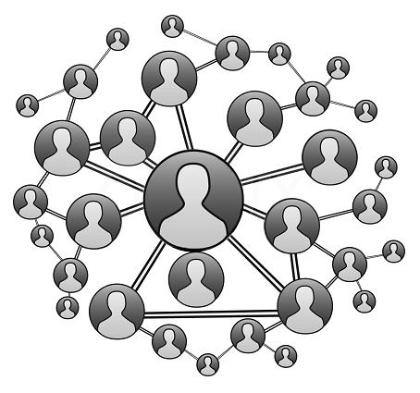

Autonomous Priority Based Routing For Online Social Networks
Dissertation Defense
Salem Othman
Supervisor: Prof Javed Khan
May-2018
Lab: MEDIANET
Department : Computer Science

Slide 2
Introduction and Motivation
Social Online Routing Protocol (SOR)
Efficiency of SOR
Autonomous Social Priority
Privacy Preservation ability of SOR
Contribution and Future Work
Stratified Privacy Model (SPM)
Related Work and Research Questions
The Solution

Slide 3


Introduction and Motivation
Today’s Online Social Networks (OSNs) issues:
  Essential built for connecting friends, acquaintances, family, and others.
  Focus was sharing comments, photos, and videos.
  Individuals can only interact with their adjacent neighbors.
Future Online Social Networks:
  Support interaction with people indirectly connected for:
    Shadowing a professional in an area of interest.
    Searching for tutors.
    Looking for babysitters.
  Matches today’s application needs.

Slide 4

Real Example (1) of Social Routing
The only country in Arab nation speaks formal Arabic is Mauritania. I was looking for Arabic teacher from Mauritania to teach my kids. I do not need to be in trouble with some one I do not know.
My Explicit Requirements:
  Arabic Teacher
  Must be from Mauritania
  Paid
  High Trust
My Implicit Requirements:
  Gender (M/F)
  Age >30

Slide 5



Real Example (2) of Social Routing
A professor at Hiram college is looking for professional in software engineering area to mentor her son as part of senior high school program.
Her Explicit Requirements:
  Someone who would be willing to let them watch and learn about a career in computer science or more specifically software engineering.
  In Cleveland area
  This would occur over the course of a few weeks in early May.
Her Implicit Requirements:
  Unknown to me.

Slide 6



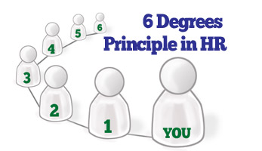
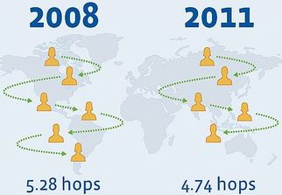
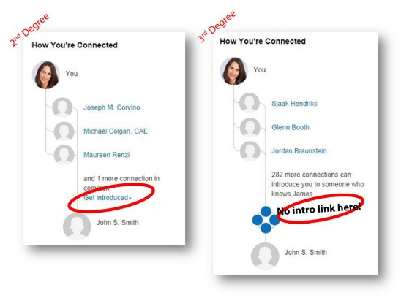
No Protocol for Online Social Routing
None
None
Requesting an Introduction
Social Routing Protocol Is needed

Slide 7
Introduction and Motivation
Social Online Routing Protocol (SOR)
Efficiency of SOR
Autonomous Social Priority
Privacy Preservation ability of SOR
Contribution and Future Work
Stratified Privacy Model (SPM)
Related Work and Research Questions

Slide 8
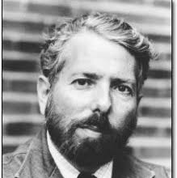
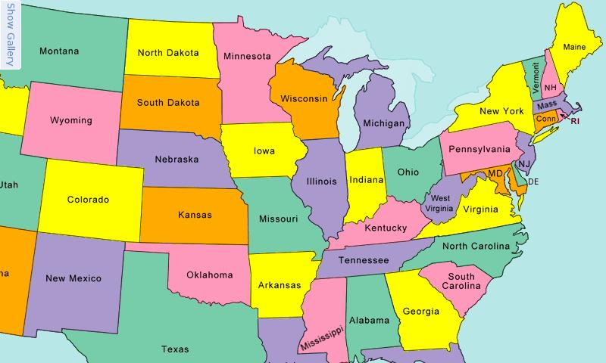
The Small-World Phenomenon: Experiment
The Origins: [Milgram 1967]
Understanding Human Routing is Important
Experiment Goal: determine how many acquaintances it would take to pass a letter between two randomly selected people.
Experiment Setup:
Define a single target person and a group of starting persons
Generate an acquaintance chain from each starter to the target
Target: Boston
Stockbroker
100 Nebraska Stockholders
100 Boston Random
96 Nebraska Random
Structure of routing: Milgram found that people are able to find shortest (near optimum steps) paths in real-world social networks using decentralized algorithm based on local information.

Slide 9
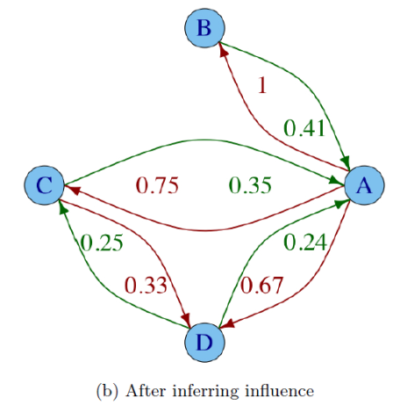

(Hangal, MacLean, Lam, & Heer, 2010, ACM)
They presented influence as an asymmetric measure of tie strength between two nodes.
The influence a person A has over person B is defined as the proportion of B’s investments B makes on A.
Structure of routing: They use Djikstra's algorithm to compute the shortest path between two nodes

Slide 10
(Jia, Juste, & Figueiredo, 2013, IEEE)
Their work shows that the routing performance improves (By 35%) through the use of two social dimensions:
  Geographic location and
  Personal interest
For future work, They plan on analyzing the impact of other dimensions such as
  Occupation or
  Popularity
“Nonetheless, there does not exist a definite decentralized algorithm for efficient social routing in most naturally occurring social networks, especially those created by online social networking sites such as LiveJournal, Facebook, and Twitter.”
No algorithm has yet been found for efficient social routing in current OSNs
Structure of routing: They use greedy routing algorithm with function to measure the similarity between next node and target node.

Slide 11

Summary Of The Related Work
Researchers assume all network information is available to the routing algorithm.
They do not define the Information elements that need to be exchanged.
They use limited number of social features to guide routing.
They assume that all individuals use same set of social factors.
They do not take privacy into consideration.
Thus, these algorithms are far from creating a fully usable social routing protocol.

Slide 12

Problem Description
This study attempts to bridge the gap by designing a social routing protocol that allows information to be shared to make social routing possible in current OSNs, while taking privacy into consideration.

Slide 13

Research Questions
Is it possible to construct a protocol that will satisfy reachability, efficiency and privacy in order to apply social routing in current OSNs platforms such as Facebook and Google+?
Is it possible to provide defensive mechanisms that individuals can use to protect their Identity information?
How can the degree of anonymity of individuals in OSNs be quantified?
Is it possible to quantify the social priority between individuals in OSNs by using social characteristics?

Slide 14
Introduction and Motivation
Social Online Routing Protocol (SOR)
Efficiency of SOR
Autonomous Social Priority
Privacy Preservation ability of SOR
Contribution and Future Work
Stratified Privacy Model (SPM)
Related Work and Research Questions

Slide 15

Stratified Privacy Model (SPM): Information
Identity information (reachability): it defines the used Identity of a node in OSNs and should be disclosed up to varied degrees.
Connectivity information (reachability): it defines who is connected to whom in OSNs and is not freely exchangeable.
Status information (efficiency): it tells how busy an individual node happens to be in OSNSs and globally disclosable.
  A node is modeled as a priority queue and its parameters are arriving rate (λ), service rate (μ) and queue size (L).
Priority information (efficiency): it determines priority levels between individuals in OSNs and selectively disclosable.

Slide 16
SPM: Privacy Options
Identity information:
  Real Identity: the actual ID of the node and known by its adjacent neighbors.
  Globally unique Pseudo Identity: an ID given by an authorized centralized trusted organization used in place of the Real identity.
  Locally unique Pseudo Identity: a random pseudo ID used in place of the Real identity.
  Null Identity: is a blank ID used in place of the Real identity.
Connectivity information:
  Individual can allow its adjacent neighbor to disclose or hide that they are connected.
Status information:
  Individuals can decide to hide or disclose their status information.
Priority information.
  Individuals can decide to hide or disclose their priority information.

Slide 17
SPM: Three Requirements of Routing
Requirement 1: Privacy options have to be satisfied and not compromised.
  For example, if node chooses to be hidden then it will be hidden.
Requirement 2: Reachability has to be ensured in case of most restrictive privacy choices.
Requirement 3: Near optimum performance has to be guaranteed in case of most open privacy choices.

Slide 18
Introduction and Motivation
Social Online Routing Protocol (SOR)
Efficiency of SOR
Autonomous Social Priority
Privacy Preservation ability of SOR
Contribution and Future Work
Stratified Privacy Model (SPM)
Related Work and Research Questions

Slide 19
SOR Basics
Service (S): is a utility, commodity, accommodation, or activity which requires or demanded by the public and provided by organization or individual(s).
Service Consumer (SeC): an individual who needs the service and generates the I-need message to get the service.
Service Provider (SeP): is an individual who owns the service and generates the I-have message to inform consumers in the network of the service that it can provide.
Service Forwarder (SeF): is an individual who participates in forwarding the I-need message, the I-have message, and the I-thank Messages.

Slide 20
SOR Messages
I-need Message (InM): is a set of fields used by service consumers to carry a request to its destination.
I-have Message (IhM): is a set of fields used by service providers to inform the service consumers by the service.
I-thank Message (ItM): is a set of fields used to carry a response from the service consumer to the service provider and vise versa.
I-like/dislike message (IdM): is a set of fields used to inform adjacent neighbors by kind of services that willing to be received or not.
I-Ack Message (IaM): for carrying acknowledgment from forwarders to consumers.

Slide 21
SOR Tables
Messages Table (MeT): Maintains an entry for the I-need, I-have, I-thank, and I-ack messages. It is a complete log/record of all of the messages that the node has sent, forwarded, originated, and/or deleted.
Forwarding Table (FoT): Maintains an entry for each I-need message and its I-have, I-thank, and I-ack messages. It is used by all nodes to trace the I-need message and its responses messages.
Routing Table (RoT): Maintains an entry for next hop a message should take toward its destination.
Self-Interest Table (SiT): Maintains a set of rules that reflects the kind of I-need messages that the node is willing to receive or not from its adjacent neighbors and a set of rules that reflects the kind of I-need messages the node is or is not willing to forward to adjacent neighbors.
Peer-like/dislike Table (P2T): Maintains the In-Self-Interest in the field Peer-Interest-Policy.

Slide 22
SOR Policies
Propagation Policy: a set of edge and node attributes-based-rules complementary to the service fields in the I-need message, guides forwarders to determine next-hop(s).
Self-Interest Policy: a set of message attribute-based-rules which determines the interest of a node in particular kinds of I-need messages.
  In-Self-Interest Policy: is a set of rules reflect the kind of I-need messages that node willing to receive or not from its adjacent neighbors.
  Out-Self-Interest Policy: is a set of rules reflect the kind of I-need messages that node willing to forward or not to next adjacent neighbors.
Peer Interest Policy: a set of In-Self-Interest policies of outgoing neighbors which is sent to the node.

Slide 23
Example
9 nodes and 12 edges
Colin
USA,37
George
USA,23
F/F:0.1
F/F:0.8
F/F:0.5
F/F:0.2
Bill
USA,25
F/F:0.5
David
USA,40
Fred
Canada,17
F/F:0.6
Alice
Libya,20
C/C:0.1
C/C:0.9
F/F:0.5
F/F:0.3
F/F:0.7
Adam
USA, 33
Elena
Libya,22
AMIR
Libya,28
F: Friend
C: Colleague
F/F:0.9

Slide 24

I-like/dislike Dissemination Phase: Create
Colin
USA,37
George
USA,23
F/F:0.1
F/F:0.8
F/F:0.5
F/F:0.2
Bill
USA,25
F/F:0.5
David
USA,40
Fred
Canada,17
F/F:0.6
Alice
Libya,20
C/C:0.1
C/C:0.9
F/F:0.5
F/F:0.3
F/F:0.7
Adam
USA, 33
Create I-like/dislike Message
Elena
Libya,22
AMIR
Libya,28
F/F:0.9
AMIR-To-Elena = <[a₁:Service Type = babysitter, a₂:Service Action = Online, a₃:Has Hidden =True] :: [((a₂~&a₃~)&a₁)]>

Slide 25
I-like/dislike Dissemination Phase: Update SiT
Colin
USA,37
George
USA,23
F/F:0.1
F/F:0.8
F/F:0.5
Self-Interest Table (SiT) of AMIR
F/F:0.2
PID | Self-Interest-Policy | Direction | My-Action | Intensity | List-Of-Neighbors
001 | AMIR-To-Elena = <[a₁:Service Type = babysitter, a₂:Service Action = Online, a₃:Has Hidden =True] :: [((a₂~&a₃~)&a₁)]> | in | like | 0.7 | Elena
Bill
USA,25
F/F:0.5
David
USA,40
Fred
Canada,17
F/F:0.6
Alice
Libya,20
F/F:0.1
C/C:0.9
F/F:0.5
F/F:0.3
F/F:0.7
Adam
USA, 33
Create I-like/dislike Message
Elena
Libya,22
AMIR
Libya,28
F/F:0.9

Slide 26
I-like/dislike Dissemination Phase: Send & Receive
Colin
USA,37
George
USA,23
F/F:0.1
F/F:0.8
F/F:0.5
F/F:0.2
Bill
USA,25
F/F:0.5
David
USA,40
Fred
Canada,17
F/F:0.6
Alice
Libya,20
C/C:0.1
C/C:0.9
F/F:0.5
F/F:0.3
F/F:0.7
Adam
USA, 33
Elena
Libya,22
AMIR
Libya,28
F/F:0.9

Slide 27
I-like/dislike Dissemination Phase: Update P2T
Colin
USA,37
George
USA,23
F/F:0.1
F/F:0.8
F/F:0.5
Peer-like/dislike Table (P2T) of Elena
F/F:0.2
Neighbor-ID | LID | Peer-Interest-Policy | Action-Requested-By-Peer
AMIR | 001 | AMIR-To-Elena = <[a₁:Service Type = babysitter, a₂:Service Action = Online, a₃:Has Hidden =True] :: [((a₂~&a₃~)&a₁)]> | like
Bill
USA,25
F/F:0.5
David
USA,40
Fred
Canada,17
F/F:0.6
Alice
Libya,20
F/F:0.1
C/C:0.9
F/F:0.5
F/F:0.3
F/F:0.7
Adam
USA, 33
Elena
Libya,22
AMIR
Libya,28
F/F:0.9

Slide 28
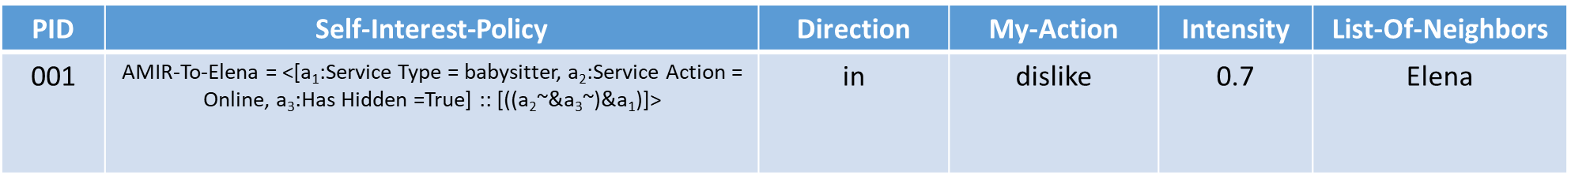
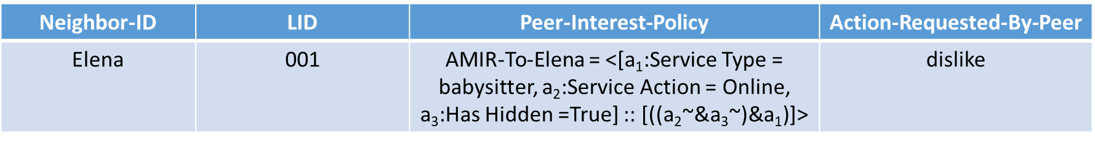
I-like/dislike Dissemination Phase
Colin
USA,37
George
USA,23
F/F:0.1
F/F:0.8
F/F:0.5
F/F:0.2
Bill
USA,25
F/F:0.5
David
USA,40
Fred
Canada,17
F/F:0.6
Alice
Libya,20
C/C:0.1
C/C:0.9
F/F:0.5
F/F:0.3
F/F:0.7
Adam
USA, 33
Elena
Libya,22
AMIR
Libya,28
F/F:0.9

Slide 29
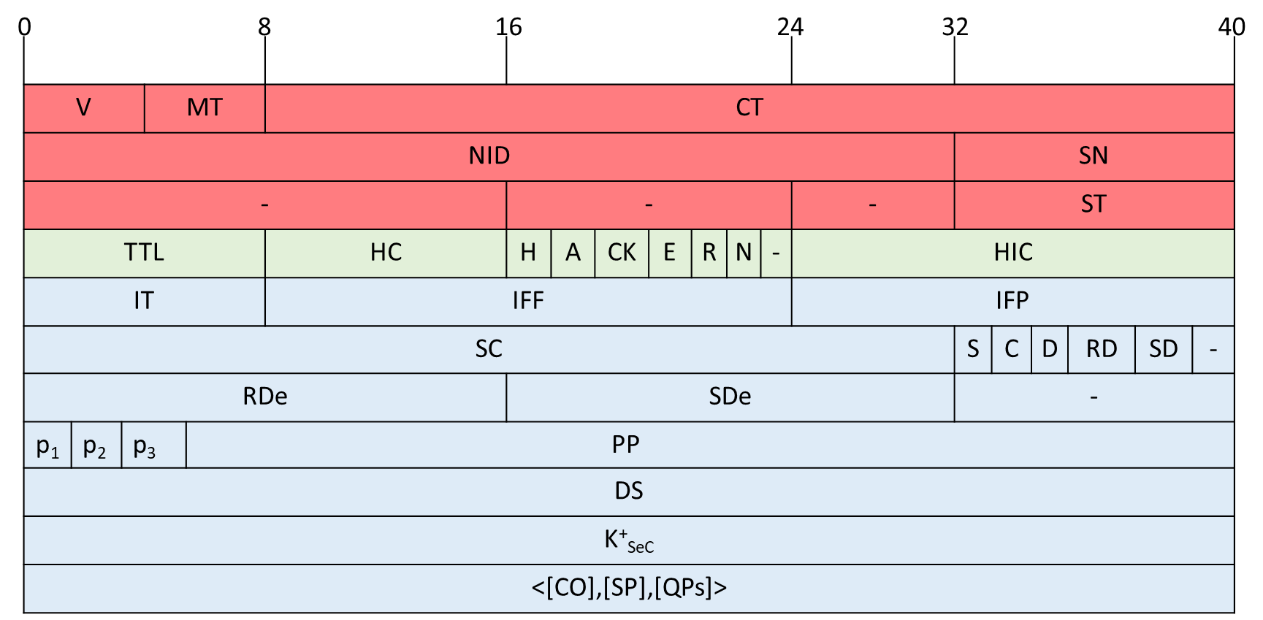

I-need Dissemination Phase: Alice Creates Msg
r₁ = <F²C>
r₂ = <[c₁:age>18, c₂:country= Libya, c₃:country=USA] :: [((c₂|c₃)&c₁)]>
Colin
USA,37
George
USA,23
[Service Type = Teacher]
F/F:0.1
F/F:0.8
F/F:0.5
I-need message
F/F:0.2
Bill
USA,25
F/F:0.5
David
USA,40
Fred
Canada,17
F/F:0.6
Alice
Libya,20
C/C:0.1
C/C:0.9
F/F:0.5
F/F:0.3
F/F:0.7
Adam
USA, 33
Elena
Libya,22
AMIR
Libya,28
F/F:0.9

Slide 30
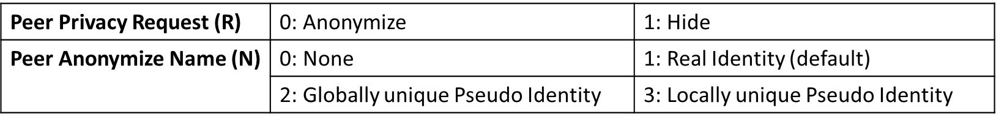
I-need Dissemination Phase: Alice chooses Identity
Colin
USA,37
George
USA,23
F/F:0.1
F/F:0.8
F/F:0.5
I-need message
F/F:0.2
Bill
USA,25
F/F:0.5
David
USA,40
Fred
Canada,17
F/F:0.6
Alice
Libya,20
F/F:0.1
C/C:0.9
F/F:0.5
F/F:0.3
F/F:0.7
ADAM
USA, 33
Elena
Libya,22
AMIR
Libya,28
F/F:0.9

Slide 31
I-need Dissemination Phase: Alice Sends to George
r₁ = <F²C>
r₂ = <[c₁:age>18, c₂:country= Libya, c₃:country=USA] :: [((c₂|c₃)&c₁)]>
Colin
USA,37
George
USA,23
F/F:0.1
F/F:0.8
F/F:0.5
F/F:0.2
Bill
USA,25
F/F:0.5
David
USA,40
Fred
Canada,17
F/F:0.6
Alice
Libya,20
C/C:0.1
C/C:0.9
F/F:0.5
F/F:0.3
F/F:0.7
Adam
USA, 33
Elena
Libya,22
AMIR
Libya,28
F: Friend
C: Colleague
F/F:0.9

Slide 32
I-need Dissemination Phase: Fred Can not Get Msg
r₁ = <F²C>
r₂ = <[c₁:age>18, c₂:country= Libya, c₃:country=USA] :: [((c₂|c₃)&c₁)]>
Colin
USA,37
George
USA,23
F/F:0.1
F/F:0.8
F/F:0.5
F/F:0.2
Bill
USA,25
F/F:0.5
David
USA,40
Fred
Canada,17
F/F:0.6
Alice
Libya,20
C/C:0.1
Alice checks the message propagation policy (PP) in I-need message against Fred’s social features and their link attributes, and does not send the message if there is no match.
C/C:0.9
F/F:0.5
F/F:0.3
F/F:0.7
ADAM
USA, 33
Elena
Libya,22
AMIR
Libya,28
F: Friend
C: Colleague
F/F:0.9

Slide 33
I-need Dissemination Phase: Alice Sends to Elena
r₁ = <F²C>
r₂ = <[c₁:age>18, c₂:country= Libya, c₃:country=USA] :: [((c₂|c₃)&c₁)]>
Colin
USA,37
George
USA,23
F/F:0.1
F/F:0.8
F/F:0.5
F/F:0.2
Bill
USA,25
F/F:0.5
David
USA,40
Fred
Canada,17
F/F:0.6
Alice
Libya,20
C/C:0.1
C/C:0.9
F/F:0.5
F/F:0.3
F/F:0.7
Adam
USA, 33
Elena
Libya,22
AMIR
Libya,28
F: Friend
C: Colleague
F/F:0.9

Slide 34
I-need Dissemination Phase: George Adds identity
r₁ = <F²C>
r₂ = <[c₁:age>18, c₂:country= Libya, c₃:country=USA] :: [((c₂|c₃)&c₁)]>
Colin
USA,37
George
USA,23
F/F:0.1
F/F:0.8
F/F:0.5
F/F:0.2
Bill
USA,25
F/F:0.5
David
USA,40
Fred
Canada,17
F/F:0.6
Alice
Libya,20
F/F:0.1
C/C:0.9
F/F:0.5
F/F:0.3
Alice
F/F:0.7
Adam
USA, 33
Elena
Libya,22
AMIR
Libya,28
F: Friend
C: Colleague
F/F:0.9

Slide 35
I-need Dissemination Phase: George Forwards to David
r₁ = <F²C>
r₂ = <[c₁:age>18, c₂:country= Libya, c₃:country=USA] :: [((c₂|c₃)&c₁)]>
Colin
USA,37
George
USA,23
F/F:0.1
F/F:0.8
F/F:0.5
F/F:0.2
Bill
USA,25
F/F:0.5
David
USA,40
Fred
Canada,17
F/F:0.6
Alice
Libya,20
C/C:0.1
C/C:0.9
F/F:0.5
F/F:0.3
F/F:0.7
Adam
USA, 33
Elena
Libya,22
AMIR
Libya,28
F: Friend
C: Colleague
F/F:0.9

Slide 36
I-need Dissemination Phase: George Update FoT
Colin
USA,37
George
USA,23
F/F:0.1
F/F:0.8
F/F:0.5
F/F:0.2
Bill
USA,25
F/F:0.5
David
USA,40
Fred
Canada,17
F/F:0.6
Alice
Libya,20
C/C:0.1
Forwarding Table (FoT) of George
C/C:0.9
F/F:0.5
F/F:0.3
NID | SN | PP | RDe | K⁺_{SeC} | Received-From | Sent-To | Name | SP | [QPs] | HID | RDe₂ | TID | AID
10 | 1 | <..> | 10:00 am |  | Alice | David | Real ID
F/F:0.7
Adam
USA, 33
Elena
Libya,22
AMIR
Libya,28
F: Friend
C: Colleague
F/F:0.9

Slide 37
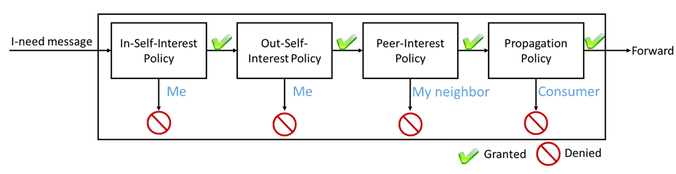
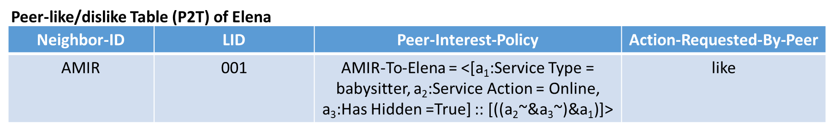
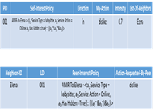
I-need Dissemination Phase: Elena forwarding Msg
Colin
USA,37
George
USA,23
F/F:0.1
F/F:0.8
F/F:0.5
F/F:0.2
Bill
USA,25
F/F:0.5
David
USA,40
Fred
Canada,17
F/F:0.6
Alice
Libya,20
C/C:0.1
Only Babysitter
C/C:0.9
F/F:0.5
F/F:0.3
F/F:0.7
Adam
USA, 33
Elena
Libya,22
AMIR
Libya,28
F/F:0.9
Notes:
Now, let me give you some details about the forwarding process.
After receiving the I-need message from Alice, Elena will check her in-self-interest policy, her out-self-interest policy, her neighbors peer-interest policy and finally the propagation policy which associated with the I-need message to decide which one should see the I-need message.

Slide 38
I-need Dissemination Phase: Elena Forwards to David
Colin
USA,37
George
USA,23
F/F:0.1
F/F:0.8
F/F:0.5
F/F:0.2
Bill
USA,25
F/F:0.5
David
USA,40
Fred
Canada,17
F/F:0.6
Alice
Libya,20
C/C:0.1
C/C:0.9
F/F:0.5
F/F:0.3
F/F:0.7
Adam
USA, 33
Elena
Libya,22
AMIR
Libya,28
F/F:0.9

Slide 39
I-need Dissemination Phase: David Forwards to Adam
r₁ = <F²C>
r₂ = <[c₁:age>18, c₂:country= Libya, c₃:country=USA] :: [((c₂|c₃)&c₁)]>
Colin
USA,37
George
USA,23
[Service Type = Teacher]
F/F:0.1
F/F:0.8
F/F:0.5
F/F:0.2
Bill
USA,25
F/F:0.5
David
USA,40
Fred
Canada,17
F/F:0.6
Alice
Libya,20
C/C:0.1
C/C:0.9
F/F:0.5
F/F:0.3
F/F:0.7
Adam
USA, 33
Elena
Libya,22
AMIR
Libya,28
F: Friend
C: Colleague
F/F:0.9
AMIR-To-Elena = <[a₁:Service Type = babysitter, a₂:Service Action = Online, a₃:Has Hidden =True] :: [((a₂~&a₃~)&a₁)]>

Slide 40

I-have Dissemination Phase: Adam Creates Msg
George, Elena, and Alice do not hide connectivity information (they use real Identities).
Service Forwarders
George
Service Consumer
David
Alice
Create I-have Message
Service Provider
Adam
Elena

Slide 41
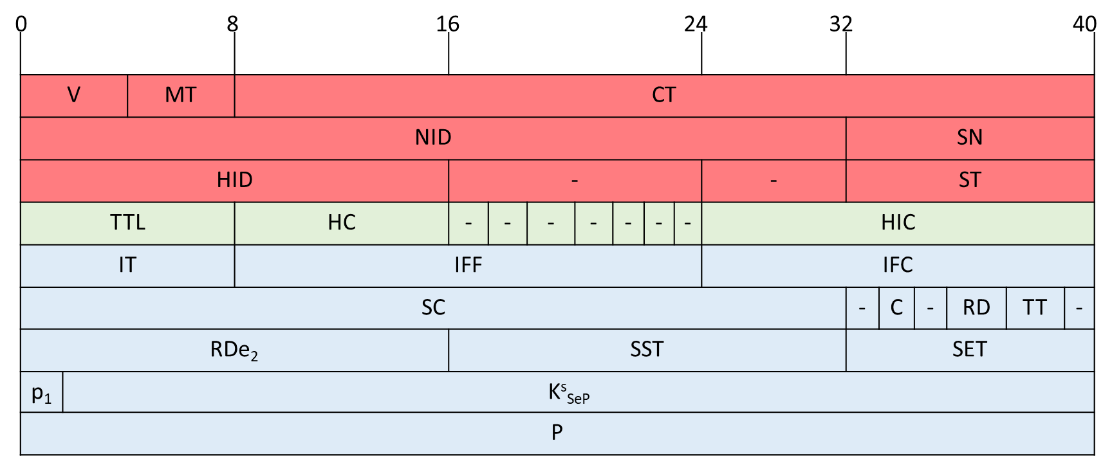
I-have Dissemination Phase: Adam Creates Msg
George, Elena, and Alice do not hide connectivity information (they use real Identities).
Service Forwarders
George
Service Consumer
David
Alice
Create I-have Message
Service Provider
Adam
Elena

Slide 42
I-have Dissemination Phase: Adam chooses Path
George, Elena, and Alice do not hide connectivity information (they use real Identities).
Service Forwarders
George
Service Consumer
David
Alice
Service Provider
Adam
Elena

Slide 43
I-have Dissemination Phase: Adam sends Msg to David
Service Forwarders
George
Service Consumer
David
Alice
Service Provider
Adam
Elena

Slide 44
I-have Dissemination Phase: David sends Msg to Elena
Service Forwarders
George
Service Consumer
David
Alice
Service Provider
Adam
Elena
Notes:
David sends the I-have message to Elena

Slide 45
I-have Dissemination Phase: Elena sends Msg to Alice
Service Forwarders
George
Service Consumer
David
Alice
Service Provider
Adam
Elena

Slide 46
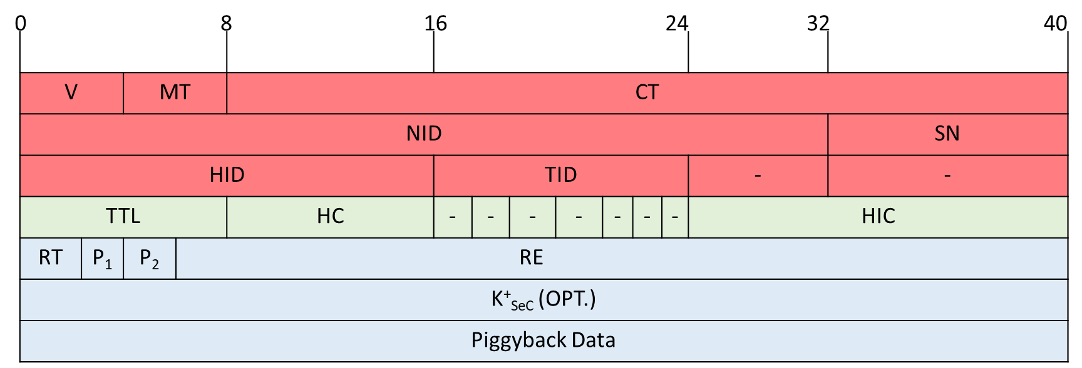

I-thank Dissemination Phase: Alice Creates Msg
Service Forwarders
George
Service Consumer
David
Alice
Service Provider
Create I-thank Message
Adam
Elena

Slide 47
I-thank Dissemination Phase: Alice Sends Msg to Elena
Service Forwarders
George
Service Consumer
David
Alice
Service Provider
Adam
Elena

Slide 48
I-thank Dissemination Phase: Elena Sends Msg to David
Service Forwarders
George
Service Consumer
David
Alice
Service Provider
Adam
Elena

Slide 49
I-thank Dissemination Phase: David Sends Msg to Adam
Service Forwarders
George
Service Consumer
David
Alice
Service Provider
Adam
Elena

Slide 50
Introduction and Motivation
Social Online Routing Protocol (SOR)
Efficiency of SOR
Autonomous Social Priority
Privacy Preservation ability of SOR
Contribution and Future Work
Stratified Privacy Model (SPM)
Related Work and Research Questions

Slide 51

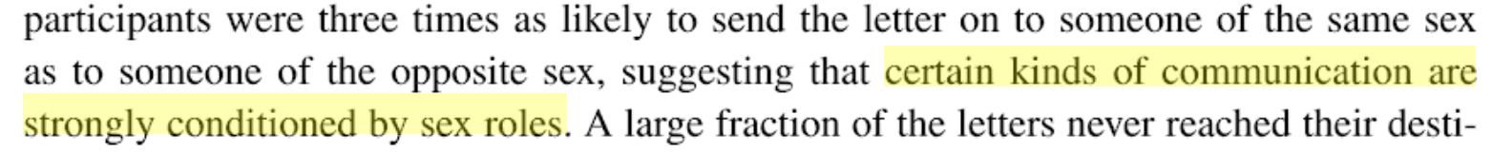
Social Aspect of Priority
FaceBook
University:
  Professors may have different relationships.
Family:
  Family members may have a higher level of importance than others, and different friends have different priorities assigned to them based on their social centralities or their gender.
Milgram, 1967:
  Found that “certain kinds of communication are strongly conditioned by sex roles”.

Slide 52
Types Of Features
Four types of features can be used
  Neighbors’ properties: Degree, Betweeness, Closeness, Eigenvector centralities, and Clustering coefficient.
  Neighbors’ profiles: Gender, institution, Birthdate, Relationship ties, job-title, and place.
  Neighbors’ activities: Likes, Shares, Posts, Comments, Poke, Tweets and Retweets.
  Node judgment: Influence, Trust/Distrust, Support/Oppose, Friend/Foe, and Authority.

Slide 53
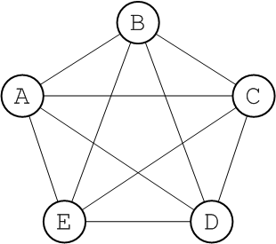
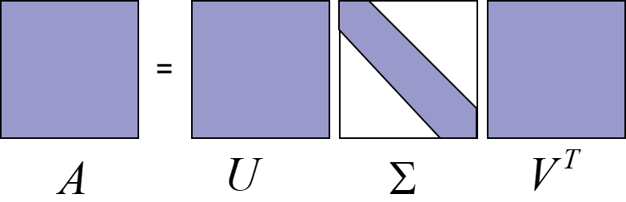
Autonomous Social Priority as Local Attribute
Input:
Output:
Unweight Social Graph
Weight Social Graph
0.7
0.3
Calculate the Feature
Values
Do a reduction of future
space using SVD to
Compute the Priority
Assign the priority on
Edges of the given
Social Graph
0.3
0.2
0.9
0.7
0.9
Set of Features
Social priorities in small groups tend to be normally distributed

Slide 54
Introduction and Motivation
Social Online Routing Protocol (SOR)
Efficiency of SOR
Autonomous Social Priority
Privacy Preservation ability of SOR
Contribution and Future Work
Stratified Privacy Model (SPM)
Related Work and Research Questions

Slide 55
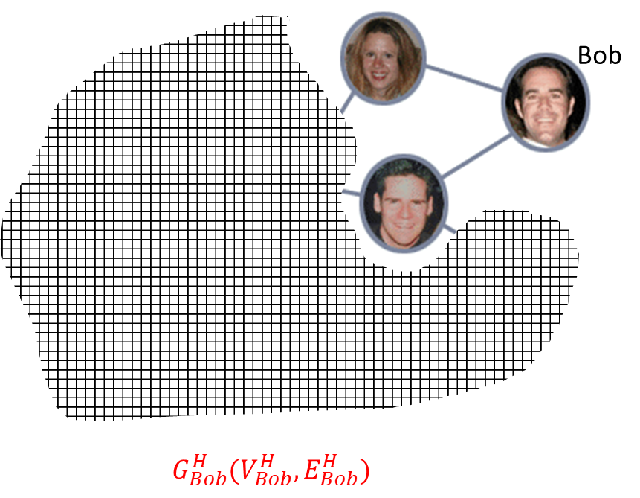
Identity choices
Real Identity (default): is the actual ID of the node and known by its adjacent neighbors.
Globally unique Pseudo Identity: is given by an authorized centralized trusted organization and known to everyone in the network. This identity is introduced for certain applications requiring cumulative credit for social or economic benefits.
Locally unique Pseudo Identity: is a random pseudo ID used in place of the Real identity of the node.
Null Identity: is a blank ID used by nodes to hide their local identities.

Slide 56

Validity of Privacy Requirements from individual perspective
Requirement one has been met.
Property 1: In SOR protocol, if node v sends an I-need message m to node u and it chooses to be hidden from all others in S_{u}= {neighbors of node u} except for u, then it will be hidden.
Worst-case scenario:
There is an edge between v and the attacker z.
z knows the real identities of the nodes.
Assumption:
There is no external information node z can collect about node v.
v
u
Proof:
Let u sends the message m to the attacker z after hiding v.
since v has chosen to be hidden, the certainty of node z that v sends m is:
Then the attacker certainty approaches zero when S_{u} is very large:
z
Victim
Attacker

Slide 57

Measuring Anonymity
Consumer Anonymity: a consumer is anonymous if its identity is unknown. it is measured by the size of the consumer anonymity set.
Degree of Anonymity of Consumer (D):
Consumer Anonymity Set (S): is the set of all possible consumers who could have sent a particular I-need message as observed by the attacker. The larger the anonymity set size, the more anonymity a service consumer is enjoying.
$$D=1−\frac{1}{S}$$
S is the size of the consumer anonymity set
1/S is the certainty of the adversary
Size effects by used identity and how far the I-need message travels.

Slide 58
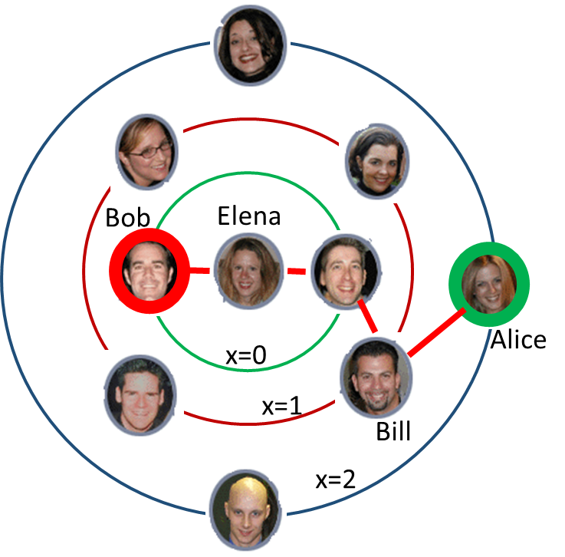
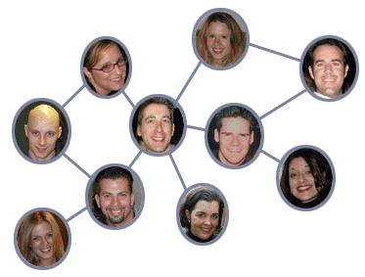
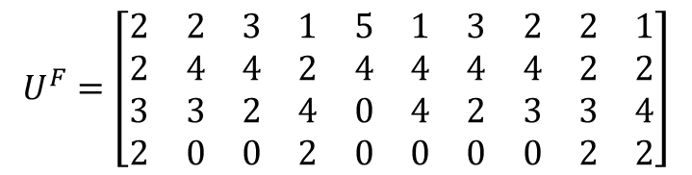
Proxima Matrix
Elena’s Proxima
Elena
$$U^{F}=\left[\begin{matrix}2 & 2 & 3 & 1 & 5 & 1 & 3 & 2 & 2 & 1 \\ 2 & 4 & 4 & 2 & 4 & 4 & 4 & 4 & 2 & 2 \\ 3 & 3 & 2 & 4 & 0 & 4 & 2 & 3 & 3 & 4 \\ 2 & 0 & 0 & 2 & 0 & 0 & 0 & 0 & 2 & 2\end{matrix}\right]$$
Elena is the last forwarder who gets the I-need message, forwarding it to Bob. She does not know that he is an attacker.
Elena
Bob
Bob is the attacker who gets the I-need message from Elena and tries to identify the owner (Alice) .
Alice is the victim, who sends the I-need message and chose to be hidden. So no one except Bill knows about her.
Bill
Alice
Bill is the first forwarder who hides Alice.

Slide 59
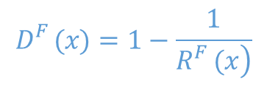
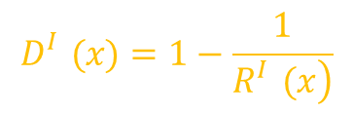
Estimation of DOA (with simple social graph)
Proxima Matrices:
  Fixed Proxima matrix (for Locally unique Pseudo Identity)
  Integrated Proxmia matrix (for Null Identity)
Proxima Distributions:
  Fixed Proxima distribution
  Integrated Proxima distribution
Proxima Degree of Anonymity:
  Fixed Proxima Degree of Anonymity
  Integrated Proxima Degree of Anonymity
U^{F}
U^{I}
R^{F}(x)
R^{I}(x)
$$D_{}^{F}(x)=1−\frac{1}{\left.R_{}^{F}(x\right)}$$
$$D_{}^{I}(x)=1−\frac{1}{\left.R_{}^{I}(x\right)}$$

Slide 60




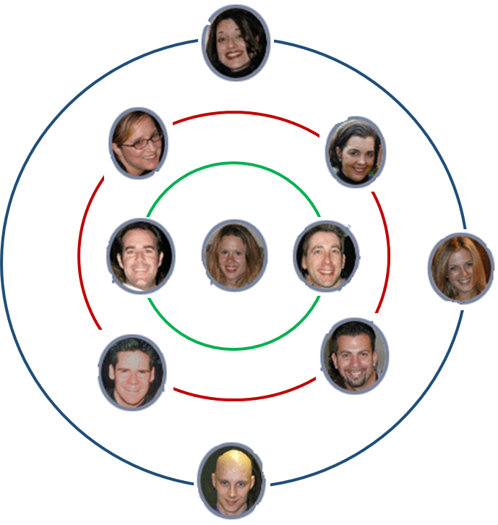



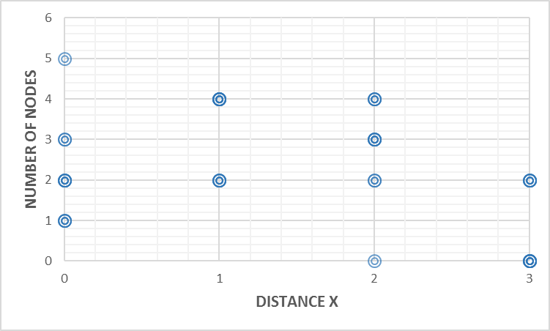


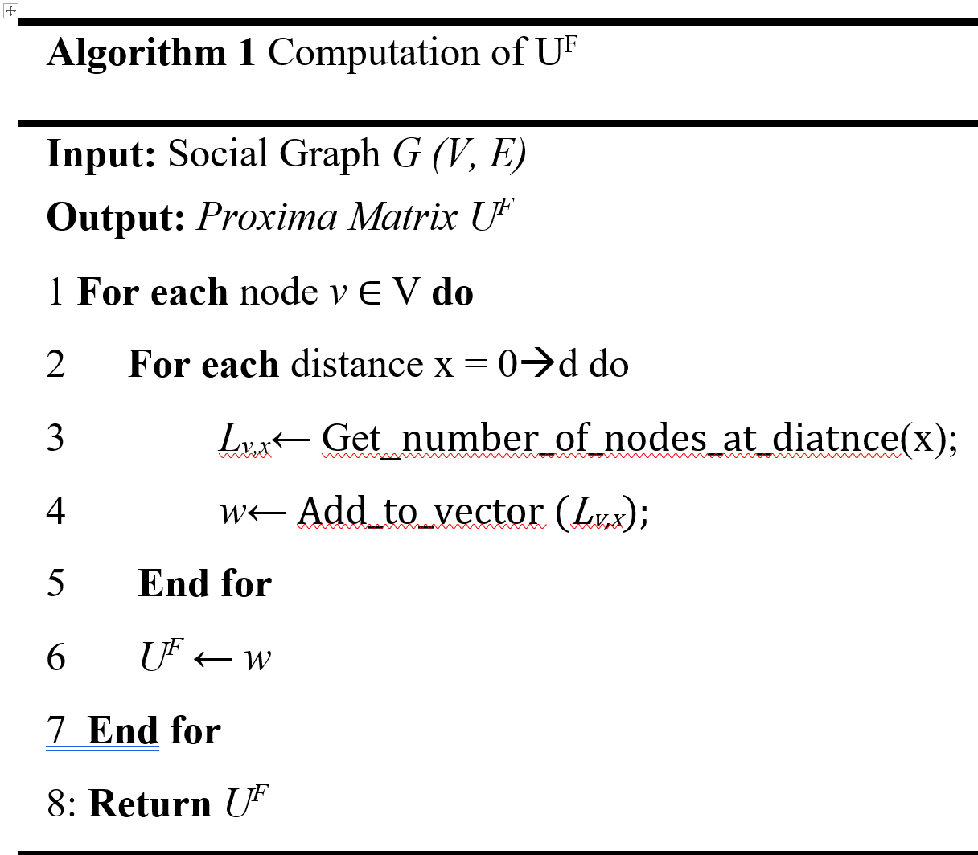


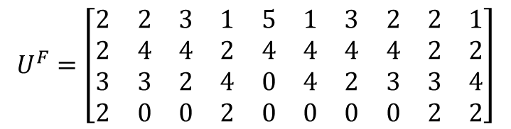
DOA for Locally unique Pseudo Identity
Fixed Proxima Matrix
$$U^{F}=\left[\begin{matrix}2 & 2 & 3 & 1 & 5 & 1 & 3 & 2 & 2 & 1 \\ 2 & 4 & 4 & 2 & 4 & 4 & 4 & 4 & 2 & 2 \\ 3 & 3 & 2 & 4 & 0 & 4 & 2 & 3 & 3 & 4 \\ 2 & 0 & 0 & 2 & 0 & 0 & 0 & 0 & 2 & 2\end{matrix}\right]$$
$$L_{x,v}=\left\{u∈V:dis\left(v, u\right)=x\right\}$$
Bob
Elena
x=0
Alice
x=1
Bill
x=2

Slide 61
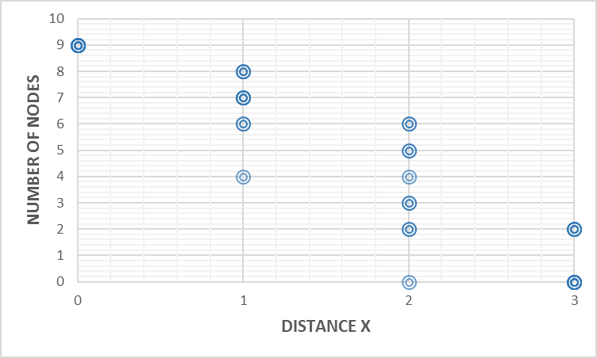
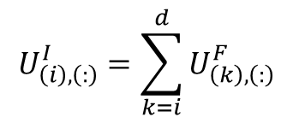
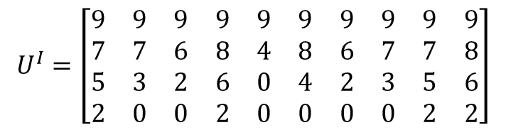
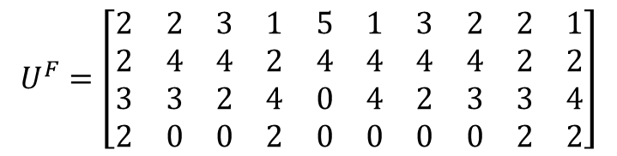
DOA for Null Identity
Fixed Proxima Matrix
Integrated Proxima Matrix
$$U^{F}=\left[\begin{matrix}2 & 2 & 3 & 1 & 5 & 1 & 3 & 2 & 2 & 1 \\ 2 & 4 & 4 & 2 & 4 & 4 & 4 & 4 & 2 & 2 \\ 3 & 3 & 2 & 4 & 0 & 4 & 2 & 3 & 3 & 4 \\ 2 & 0 & 0 & 2 & 0 & 0 & 0 & 0 & 2 & 2\end{matrix}\right]$$
$$U^{I}=\left[\begin{matrix}9 & 9 & 9 & 9 & 9 & 9 & 9 & 9 & 9 & 9 \\ 7 & 7 & 6 & 8 & 4 & 8 & 6 & 7 & 7 & 8 \\ 5 & 3 & 2 & 6 & 0 & 4 & 2 & 3 & 5 & 6 \\ 2 & 0 & 0 & 2 & 0 & 0 & 0 & 0 & 2 & 2\end{matrix}\right]$$
$$U_{\left(i\right),\left(:\right)}^{I}=\sum_{k=i}^{d}{U_{\left(k\right),\left(:\right)}^{F}}$$
The summation of its rows

Slide 62

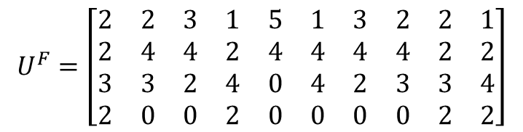

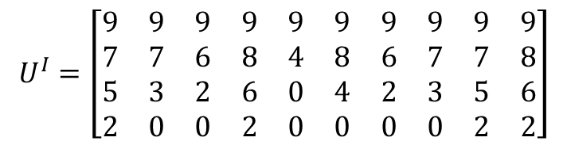

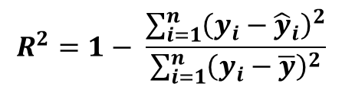
Proxima Distributions
The Polynomial Regression Model is used for estimating Proxima Distributions:
Evaluate accuracy of regression models:
Fixed Proxima Distribution
$$U^{F}=\left[\begin{matrix}2 & 2 & 3 & 1 & 5 & 1 & 3 & 2 & 2 & 1 \\ 2 & 4 & 4 & 2 & 4 & 4 & 4 & 4 & 2 & 2 \\ 3 & 3 & 2 & 4 & 0 & 4 & 2 & 3 & 3 & 4 \\ 2 & 0 & 0 & 2 & 0 & 0 & 0 & 0 & 2 & 2\end{matrix}\right]$$
$$\left[\begin{aligned}? \\ ? \\ ? \\ ?\end{aligned}\right]$$
$$P\left(x\right)=a_{0}+a_{1}∗x+a_{2}∗x^{2}+…+a_{n}∗x^{n}$$
$$P\left(x\right)= \sum_{i=0}^{n}{a_{i}x^{i}}$$
Integrated Proxima Distribution
$$U^{I}=\left[\begin{matrix}9 & 9 & 9 & 9 & 9 & 9 & 9 & 9 & 9 & 9 \\ 7 & 7 & 6 & 8 & 4 & 8 & 6 & 7 & 7 & 8 \\ 5 & 3 & 2 & 6 & 0 & 4 & 2 & 3 & 5 & 6 \\ 2 & 0 & 0 & 2 & 0 & 0 & 0 & 0 & 2 & 2\end{matrix}\right]$$
$$\left[\begin{aligned}? \\ ? \\ ? \\ ?\end{aligned}\right]$$
$$R^{2}=1− \frac{\sum_{i=1}^{n}{{\left(y_{i}−{\hat{y}}_{i}\right)}^{2}}}{\sum_{i=1}^{n}{{\left(y_{i}−\overline{y}\right)}^{2}}}$$

Slide 63
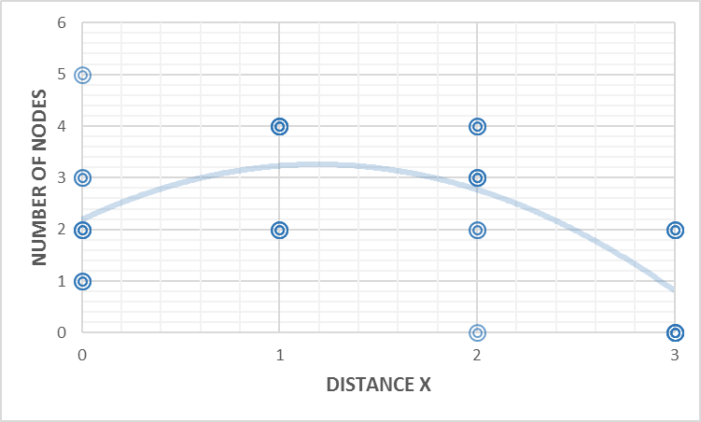
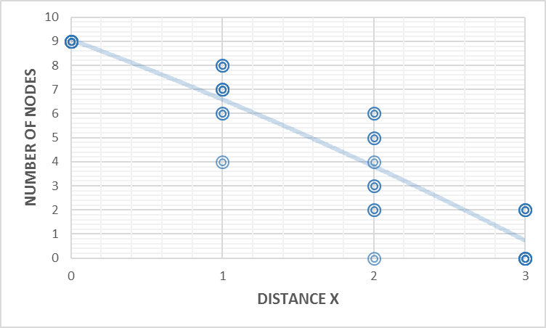


Fixed and Integrated Proxima distributions
$$R^{F}\left(x\right)=2.19+1.79x−0.75x^{2}$$
$$R^{I}\left(x\right)=9.07−2.33x−0.15x^{2}$$
R²= 0.43
R²= 0.86
0.3 < R² < 0.7 means that the response variable is moderately well-explained by the predictor variable.
R² > 0.7 means the response variable is very well-explained by the predictor variable.

Slide 64
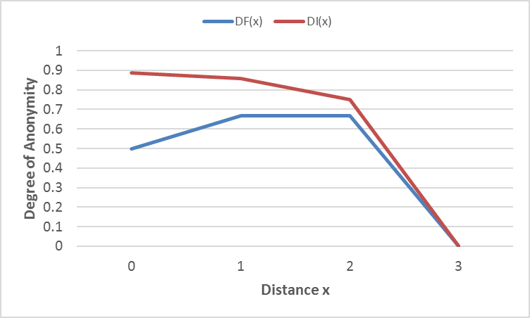
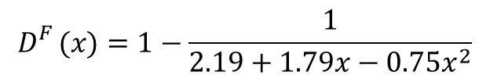
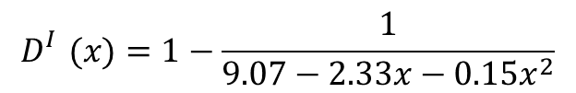
Proxima Degree of Anonymities
Fixed Proxima Degree of Anonymity:
Integrated Proxima Degree of Anonymity:
$$D_{}^{F}(x)=1−\frac{1}{2.19+1.79x−0.75x^{2}}$$
$$D_{}^{I}(x)=1−\frac{1}{9.07−2.33x−0.15x^{2}}$$
Ƥ is the number of nodes between victim and attacker.
Ƥ =0 means victim is directly connected to attacker
Ƥ =1 means one node between victim and attacker.
x=Ƥ-1, Ƥ>0
Integrated Proxima overcomes the Fixed Proxima
At distance x=3 both degree of anonymities are low
Limit message propagation to 3 hops as maximum.

Slide 65
Analysis of Anonymity for Our Large Benchmark Graph

Slide 66
Google Plus Networks
Dataset | # nodes | # edges | Avg. Node Degree | Graph Diameter
DS-1 | 54 | 203 | 7.518518519 | 5
DS-2 | 116 | 1024 | 17.65517241 | 5
DS-3 | 1079 | 46234 | 85.6978684 | 6
DS-4 | 342 | 3361 | 19.65497076 | 6

Slide 67
Locally unique Pseudo Identity: Fixed Proxima Distributions

Slide 68
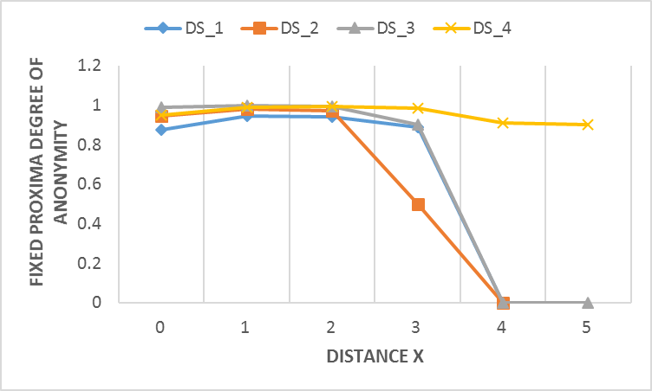
Anonymity with Locally unique Pseudo Identity
Requirement one has been met in case of Locally unique Pseudo Identity
Anonymity of all networks is high when x≤3, and declining after that point
Anonymity of most networks follows a fairly similar pattern, but the DS-4 steadily declines
Limit message propagation to 4 hops as maximum.

Slide 69
Null Identity: Integrated Proxima Distributions

Slide 70
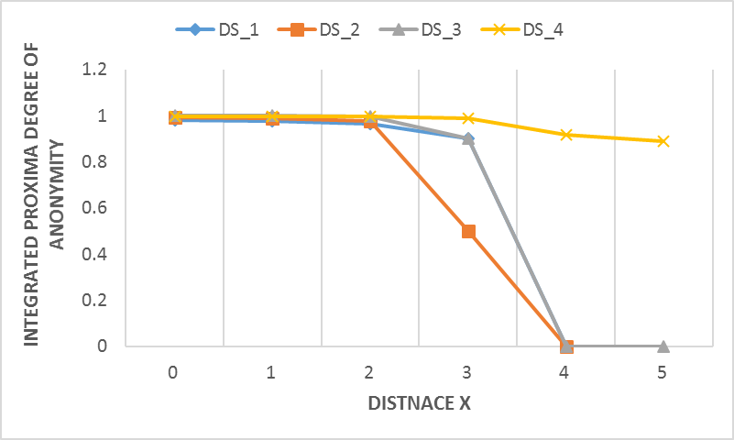
Anonymity with Null Identity
Requirement one has been met in case of Null Identity
Anonymity is high for all networks at the distance x=0
Anonymity of most networks follows a fairly similar pattern, but the DS-4 steadily declines
Limit message propagation to 4 hops as maximum.

Slide 71
Reachability
Requirement two has been met.
Property 2: In SOR protocol, if all nodes decide to be hidden then reachability is guaranteed.
v
u₀
u₁
u₂
u_{n-1}
z
Forwarding Table (FoT)
NID | SN | PP | RDe | K⁺_{SeC} | Received-From | Sent-To | Name | SP | [QPs] | HID | RDe₂ | TID | AID
10 | 1 | <..> | 10:00 am |  | u_{n-1} | Me

Slide 72
Introduction and Motivation
Social Online Routing Protocol (SOR)
Efficiency of SOR
Autonomous Social Priority
Privacy Preservation ability of SOR
Contribution and Future Work
Stratified Privacy Model (SPM)
Related Work and Research Questions

Slide 73
SOR Routing Algorithms
Based on the availability of information:
Topology aware Shortest-Path-Based Routing Algorithm (CSP): When only connectivity information is shared. High privacy, low performance.
Social-Priority-Based Routing Algorithm (SPB_{s}): When connectivity information and Priority information are shared. Moderate privacy, Moderate performance.
Queue aware Social-Priority-Based Routing Algorithm (SPB_{D}): When connectivity information, Priority information and Status information are shared. Low privacy, High performance.

Slide 74
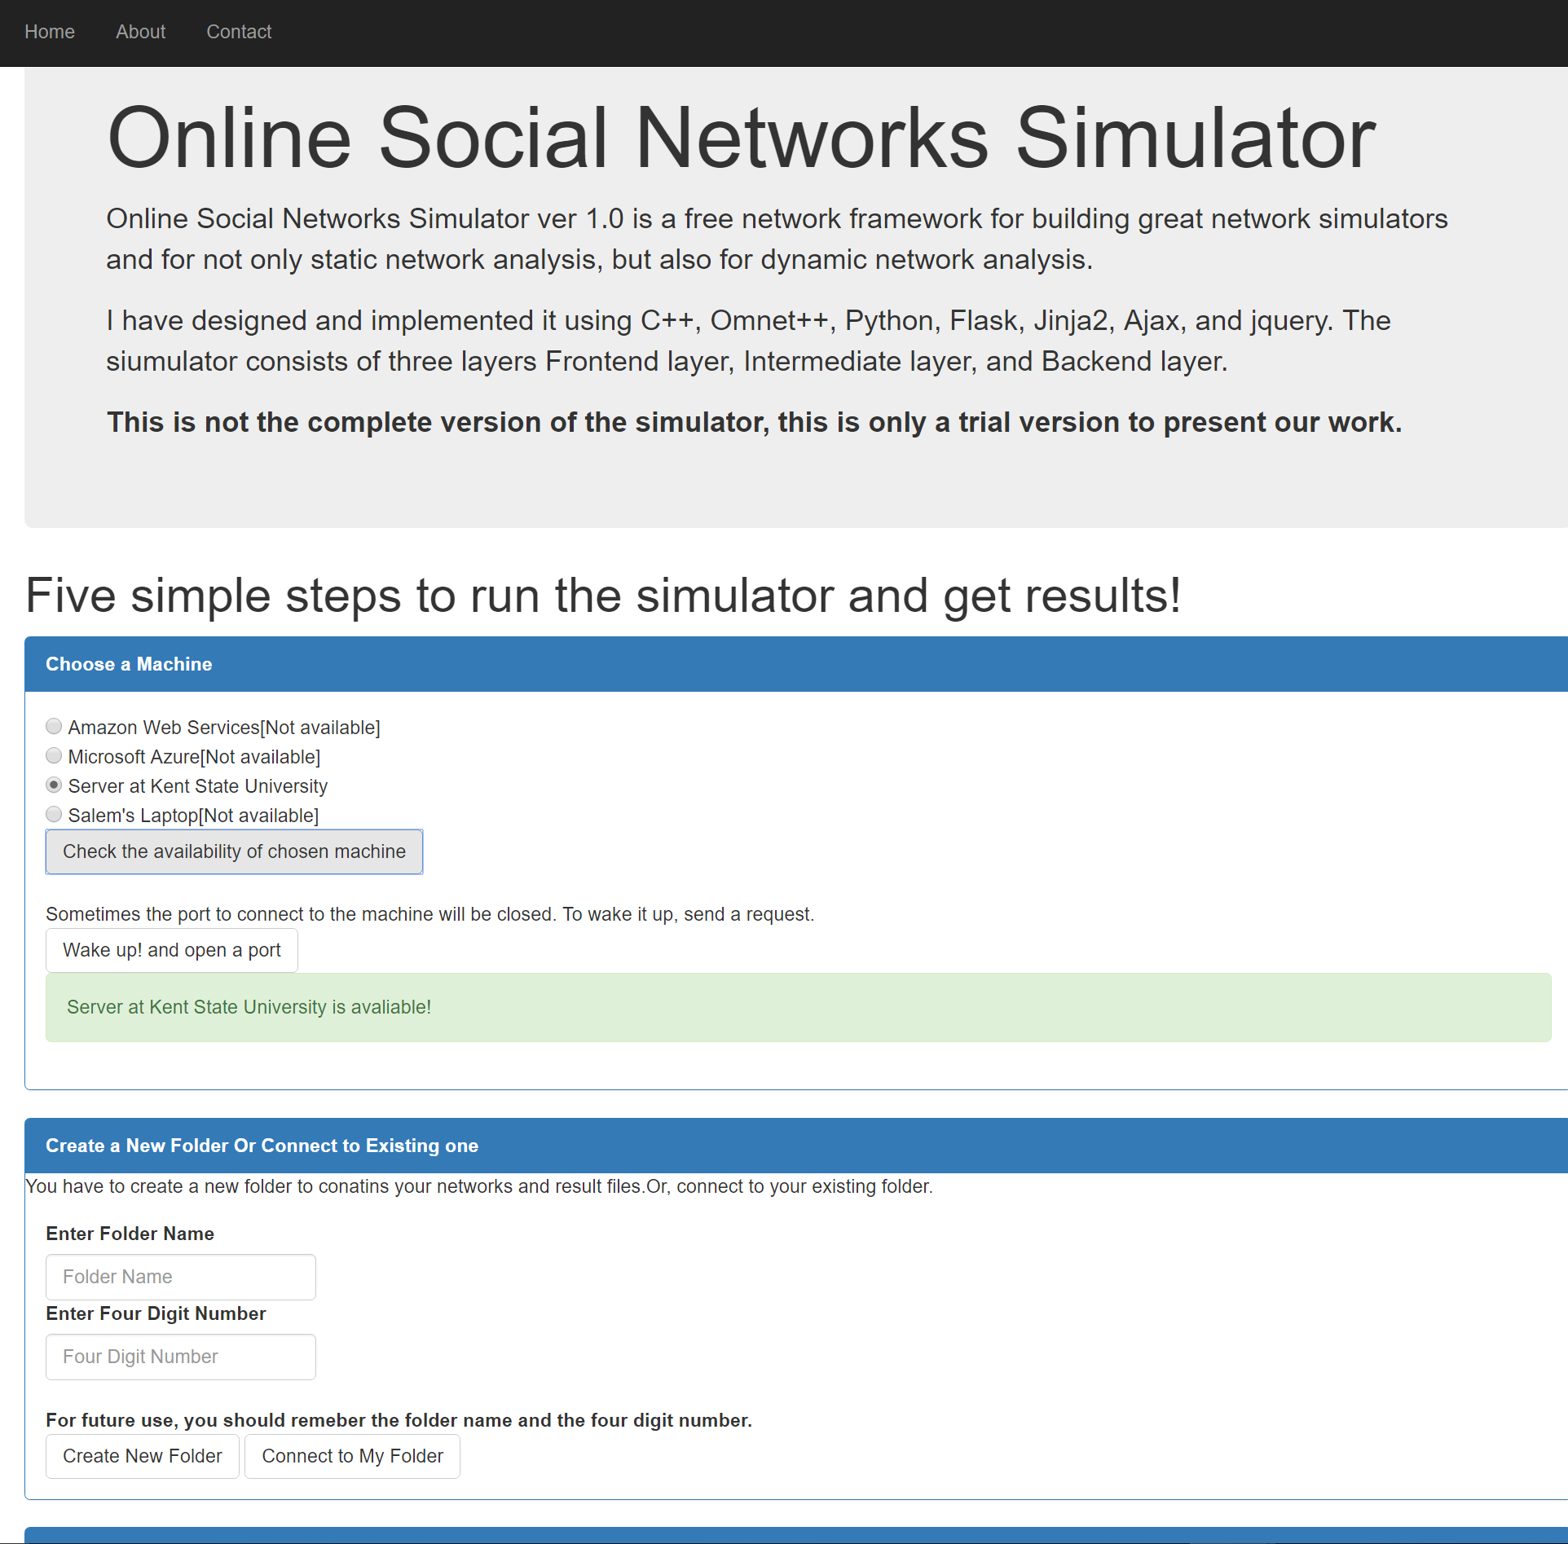
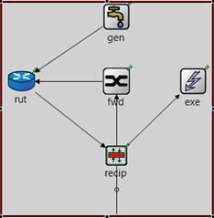
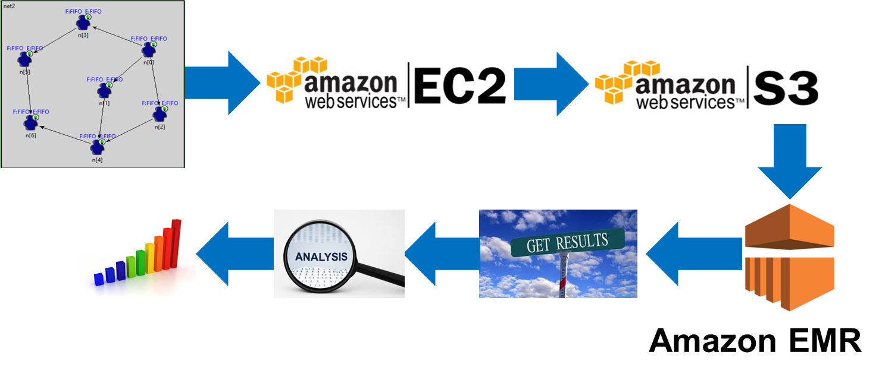
http://www.osimulator.com/
The internal interconnection of SOR node.

Slide 75
Datasets
Dataset | # nodes | # edges
DS-1 | 54 | 203
DS-2 | 116 | 1024
DS-3 | 342 | 4176
DS-4 | 1648 | 166291
DS-5 | 2211 | 93509

Slide 76
Simulation Setup
Messages generated in exponential distribution in mean 15 seconds.
Messages forwarded in exponential distribution in mean 5 seconds.
Messages served in 1 second.
We fixed the number of messages for all of the experiments and we used the same sources and destinations.

Slide 77
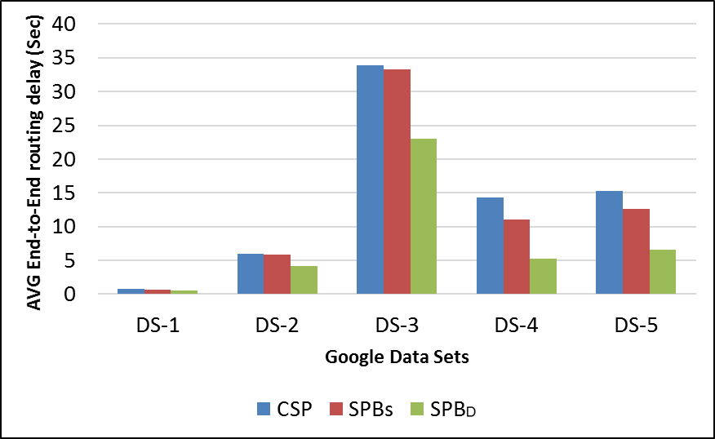
End-To-End Routing Delay
Requirement three has been met.
Connectivity information, Priority information and Status information are shared.
Connectivity information and Priority information are shared.
Average end-to-end routing delay improved when Connectivity information, Priority information, and Status information are shared.
Only connectivity information is shared

Slide 78
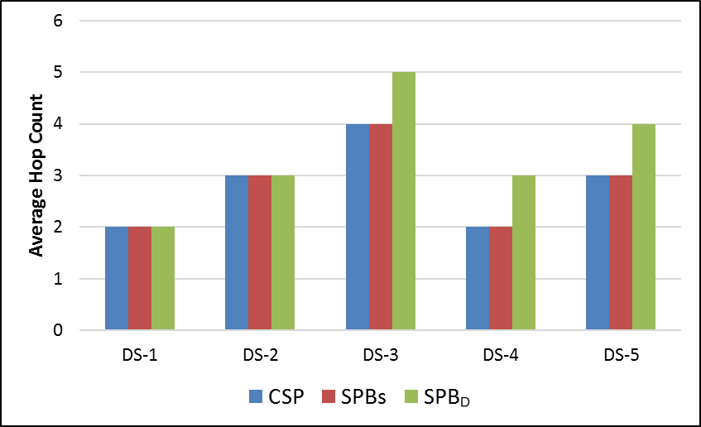
Hop Count
However, despite the significant improvements in average end-to-end delay, the average hop count increases slightly.

Slide 79
Introduction and Motivation
Social Online Routing Protocol (SOR)
Efficiency of SOR
Autonomous Social Priority
Privacy Preservation ability of SOR
Contribution and Future Work
Stratified Privacy Model (SPM)
Related Work and Research Questions

Slide 80
Contributions
A Social Online Routing (SOR) protocol that can help individuals to interact with people not directly connected to them has been designed.
  It satisfies privacy options and minimizes end-to-end routing delays corresponding to the information elements exchanged under the Stratified Privacy Model.
Defensive mechanisms that individuals can use to protect their Identity information has been introduced and analyzed.
A framework for quantify social priority between individuals in OSNs using their social characteristics has been proposed.
A simulator was designed and implemented in order to evaluate the efficiency (end-to-end routing delays) of the proposed protocol.

Slide 81
Future Work
Incentivization
  Individuals will contribute to SOR only based on their personal utility gain, so how individuals in OSNs can be motivated to use SOR. One answer to this question may be that incentive mechanisms (such as a point system or micropayment scheme) are needed.
Misbehaving
  What can encourage a selfish sender (service consumer) to create good propagation rules, and discourage the selfish consumer from creating inappropriate (wide) propagation rules?
  What mechanism can prevent forwarders from tampering with the propagation rules?

Slide 82
Future Work
Privacy of advertisement
  The I-need message can go more steps in the network and is not encrypted. The question: is there any case (e.g. application) that requires the I-need message to be encrypted? SOR protocol cannot support that. This is a research line requiring further investigation.
Security
  A hybrid cryptosystem which consists of both asymmetric and symmetric algorithms is needed to secure SOR. However, in the literature, there are plenty of public/private keys (symmetric encryption, asymmetric encryption) that are based on mechanisms such as digital signatures, digital certificates, digital envelopes, and chains of trusted nodes known as the “Web of Trust”. These mechanisms can be readily used in SOR. This is another research line needing to be investigated.

Slide 83
Future Work
Social Priority
  Some possible extensions to the social characteristic-based framework are 1) combining the requester (who is asking) with the task content (type of task); 2) including indirect Social Priority, which is given to people who are just heard about (a friend of a friend) but with whom no direct connection is made; and 3) including dynamic Social Priority, which is not fixed but changes overtime.
Application
  For various services, various fields (domain objects) should be defined and used. Application designers need to define some attributes, such those in the United Nations Standard Products and Services Code (UNSPSC) over OSN to exchange services.

Slide 84
Publications
Conference Published:
  Othman, S., Khan, J. I., & Nafa, F. (2016, July). Does Location Matter? The Efficiency of Request Propagation Based on Location in Online Social Networks. In HCI International. Springer.
  Othman, S. , Khan, J. I., & Nafa, F. (2016, January). Does Knowledge Matter?: Efficiency of Routing Delay under Imperfect Knowledge in Online Social Networks. In International Conference on Computer Games, Multimedia and Allied Technology (CGAT). Proceedings (p. 19). Global Science and Technology Forum.
  Othman, S., & Khan, J. I. (2015, March). SOR: A Protocol for Requests Dissemination in Online Social Networks. In Social Computing, Behavioral-Cultural Modeling, and Prediction (pp. 394-399). Springer International Publishing.
Journals Submitted:
  Othman, S., & Khan, J. I., Measuring Privacy in Online Social Networks using Proxima (Under review), Elsevier Computer and Security
  Othman, S., & Khan, J. I., SOR++: A Social Online Routing Protocol for Exchanging Services (Under review), Elsevier Computer Networks
In Progress:
  Salem Othman and Javed I. Khan, Strategic-Based Techniques to maximize In-Closeness Centrality of a Node in Online Social networks (Journal paper).
  Salem Othman and Javed I. Khan, k-radius of knowledge: A Case for k-Hop Routing in Online Social Networks (Conference paper).
  Salem Othman and Javed Khan, Bayesian-inference Based Social Forwarding and Routing in Online Social Networks (Conference paper).

Slide 85
Other Publications
Conference Published:
  Nafa, F., Othman, S., & Khan, J. I. (2016, April). Automatic Concepts’ Classification Based On Bloom’s Taxonomy Using Text analysis and the naïve Bayes classifier Method , In the 8th International Conference on Computer Supported Education, CSEDU.
  Nafa F. Othman S., Khan J, and Babour A. (2016). Mining Cognitive Skills Levels of Knowledge Units in Text Using Graph Triangularity Mining. IEEE/WIC/ACM International Conference on Web Intelligence (WI)
  Nafa F., Khan J, Othman S., and Babour A. (2016). Discovering Bloom Taxonomic Relationships between Knowledge Units Using Semantic Graph Triangularity Mining. International Conference on Cyber-enabled Distributed Computing and Knowledge Discovery (CyberC) 2016
  Nafa F. Othman S., Khan J, and Babour A. (2016). Semantic Graph Transitivity for Discovering Bloom Taxonomic Relationships between Knowledge Units in a Text. Proceedings of the Fifth International Conference on Intelligent Systems and Applications (INTELLI 2016)

Slide 86


Slide 87
References
Kleinberg, J. (2000, May). The small-world phenomenon: An algorithmic perspective. In Proceedings of the thirty-second annual ACM symposium on Theory of computing (pp. 163-170). ACM.
Yuan, M., L. Chen and P. S. Yu (2010). "Personalized privacy protection in social networks." Proceedings of the VLDB Endowment 4(2): 141-150.
Holme, P., B. J. Kim, C. N. Yoon and S. K. Han (2002). "Attack vulnerability of complex networks." Physical Review E 65(5): 056109.
Kleinberg, J. (2000, May). The small-world phenomenon: An algorithmic perspective. In Proceedings of the thirty-second annual ACM symposium on Theory of computing (pp. 163-170). ACM.
Martel, C., & Nguyen, V. (2004, July). Analyzing Kleinberg's (and other) small-world models. In Proceedings of the twenty-third annual ACM symposium on Principles of distributed computing (pp. 179-188). ACM.

